Slide 1
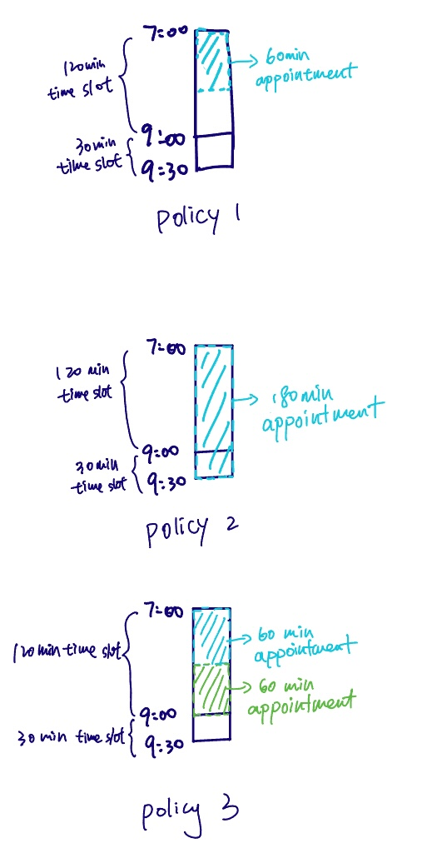
Optimal override policy for chemotherapy scheduling template
Override Policies:
Policy1: Place a patient in a longer appointment when the designated slot is no longer available.
Policy2: Combine two subsequent slots to create a slot that is equal to or greater than the amount of time required for the treatment.
Policy3: Break a longer appointment slot into two shorter slots.
Objective:
Minimize the number of override policy used in the the scheduling template

Slide 2
Models in deterministic case:
Model 1: The model in the paper (Huang et al.,2020)
Objective: minimize the number of override policy used
Decision: which policy each time slot in the template uses
Model 2: Integrated model we purposed
Objective: minimize the number of override policy used
Decision: the start time and the end time of an appointment assigned and which bed the appointment is assigned to
Model 3: Two step methods
Step 1
Objective:
Minimize the difference between the number of appointment type and the type of the time slot in each bed and the bed used
Maximize the time slot assigned in each bed
Decision: the number of each type of the appointment assigned to each bed
Step 2
Objective: minimize the number of override policy used
Decision: the start time and the end time of an appointment assigned on each bed

Slide 3
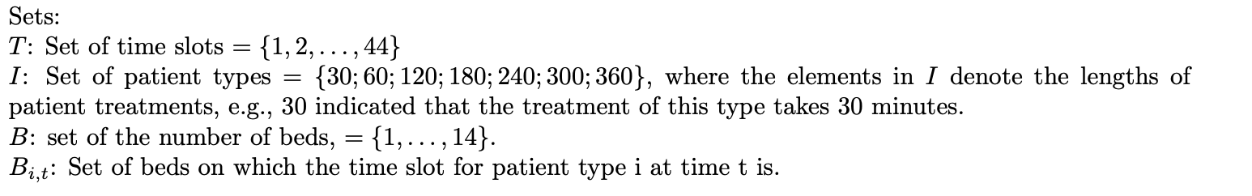
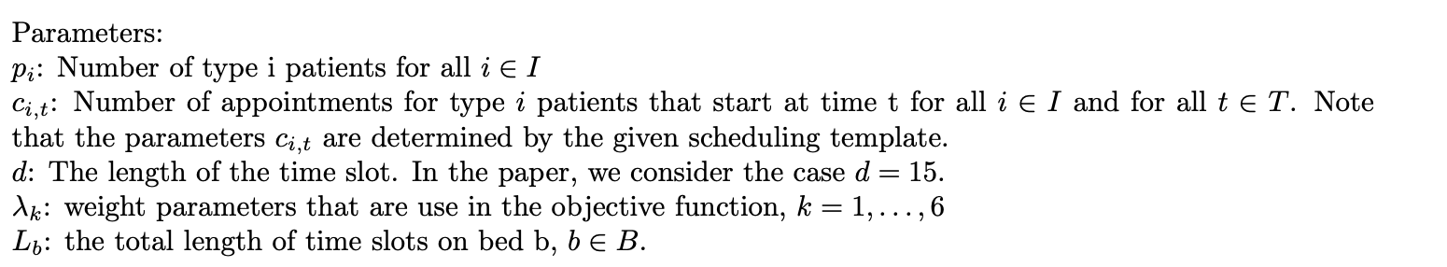
Model 1: the model from the paper (Huang et al.,2020)

Slide 4
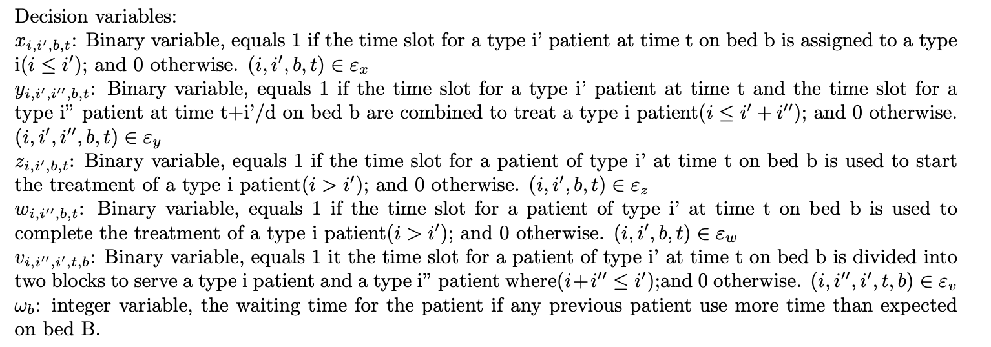
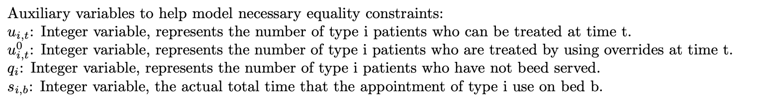
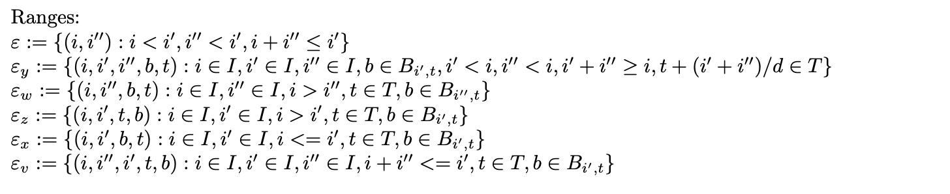
Model 1: the model from the paper
Model 1: the model from the paper (Huang et al.,2020)

Slide 5
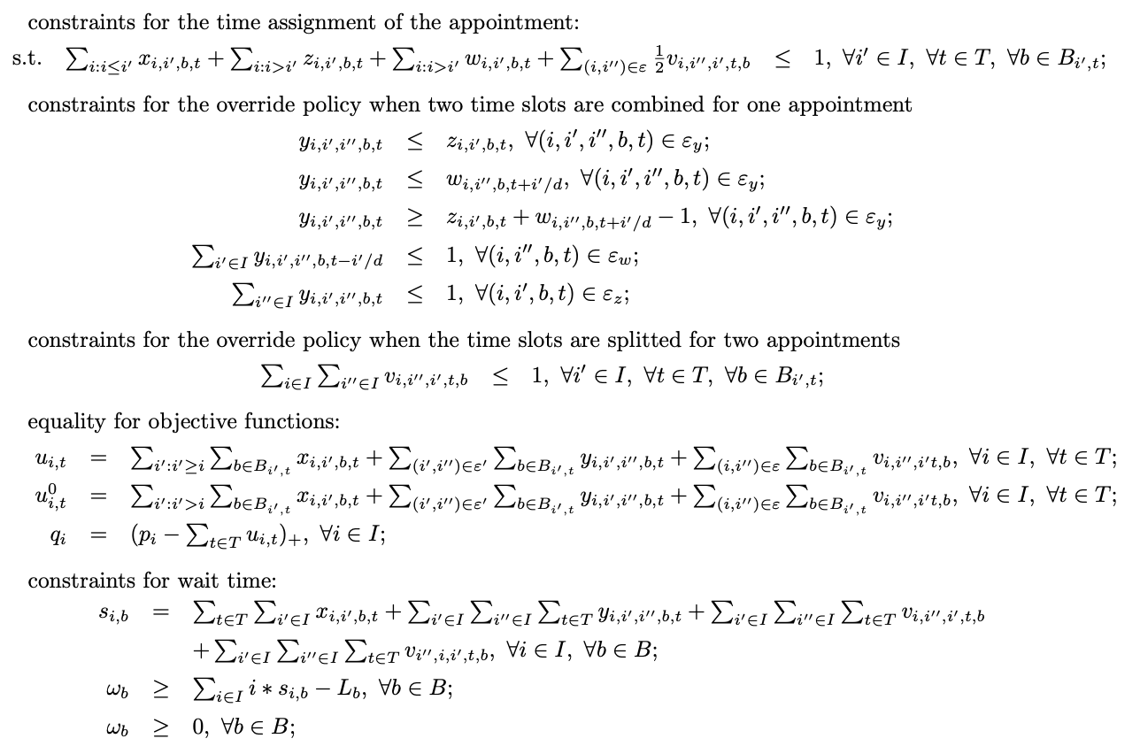
Model 1: the model from the paper
Model 1: the model from the paper (Huang et al.,2020)

Slide 6
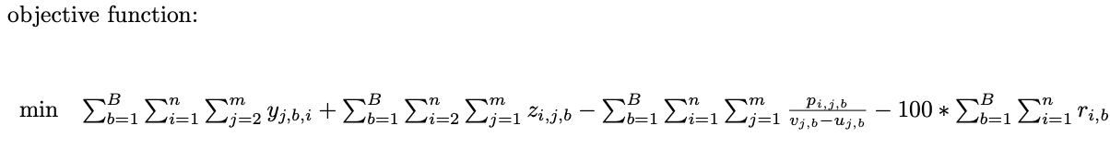
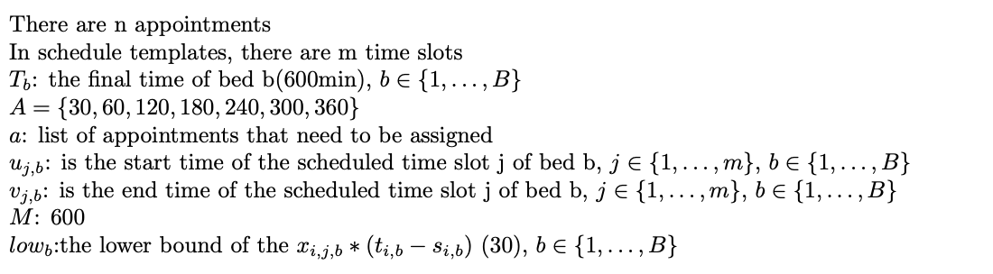
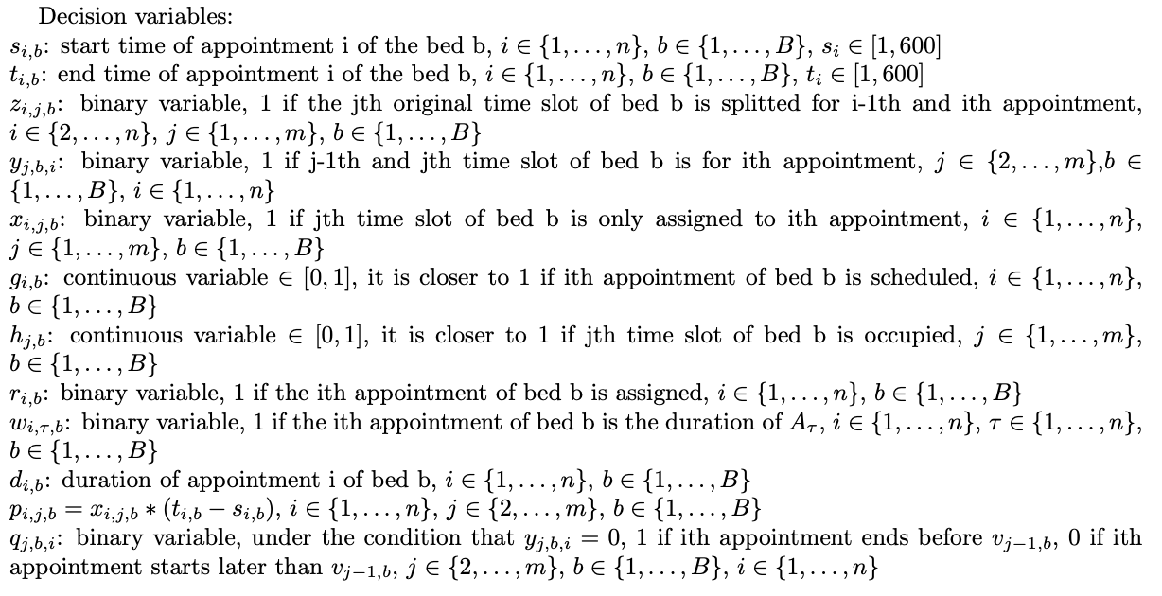
Model 2: Integrated model we purposed

Slide 7
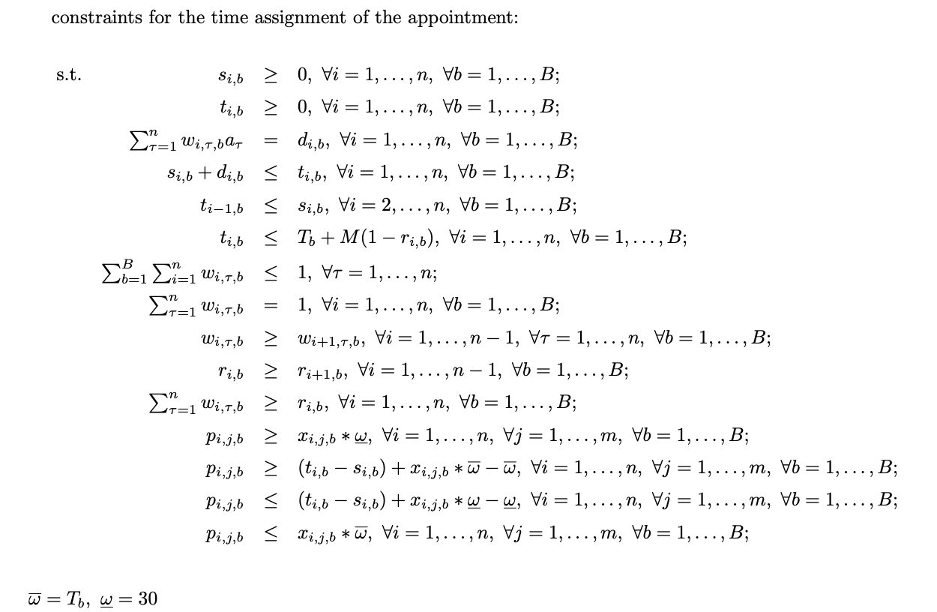
Model 2: Integrated model we purposed

Slide 8
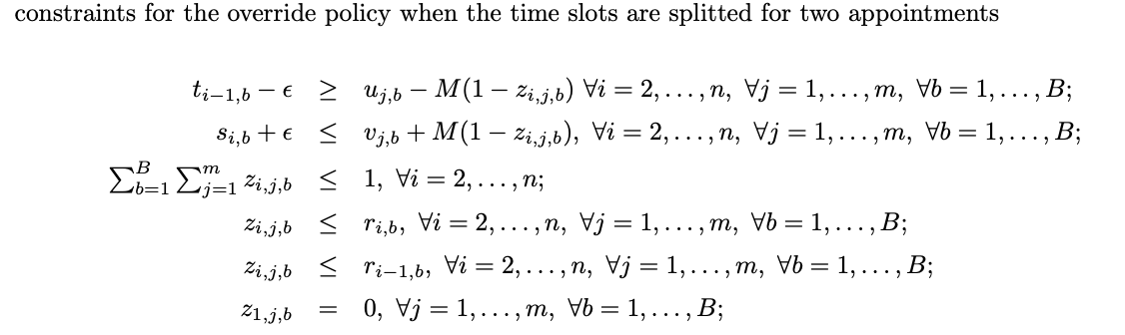
Model 2: Integrated model we purposed

Slide 9
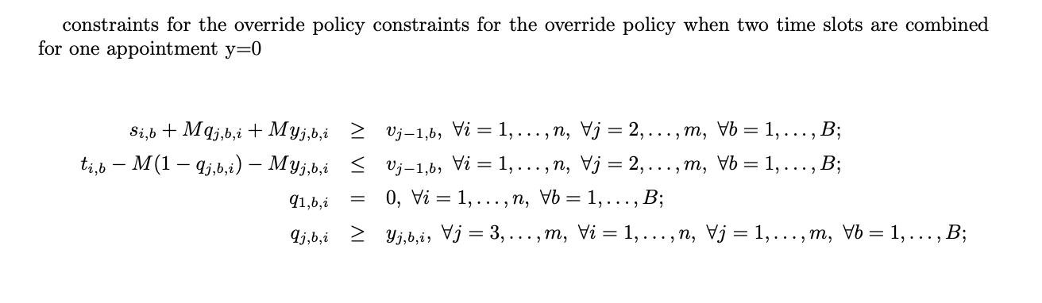
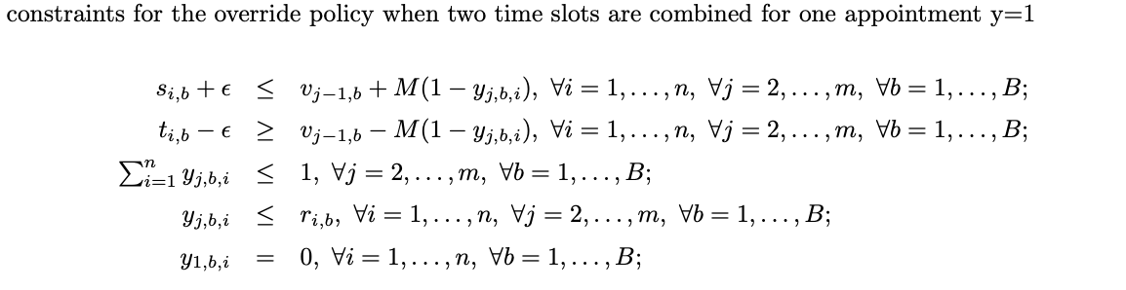
Model 2: Integrated model we purposed

Slide 10
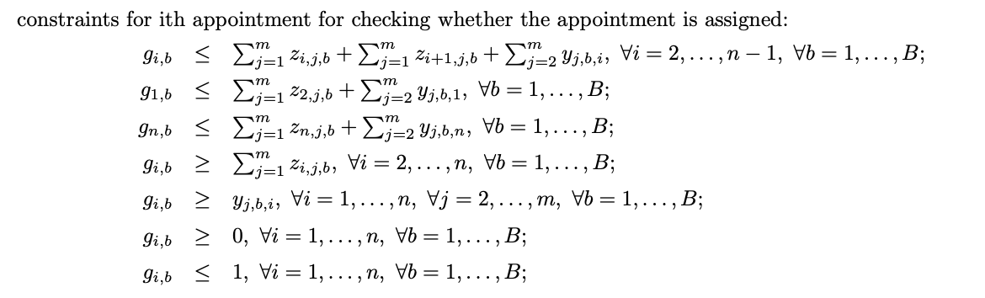
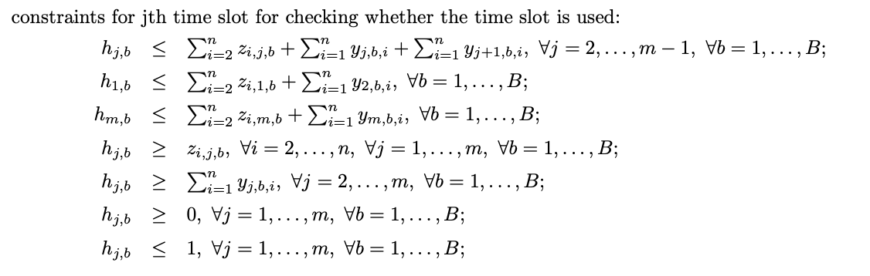
Model 2: Integrated model we purposed

Slide 11
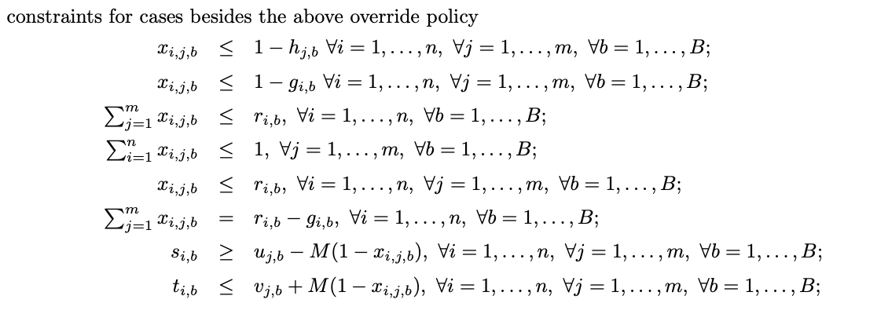
Model 2: Integrated model we purposed

Slide 12
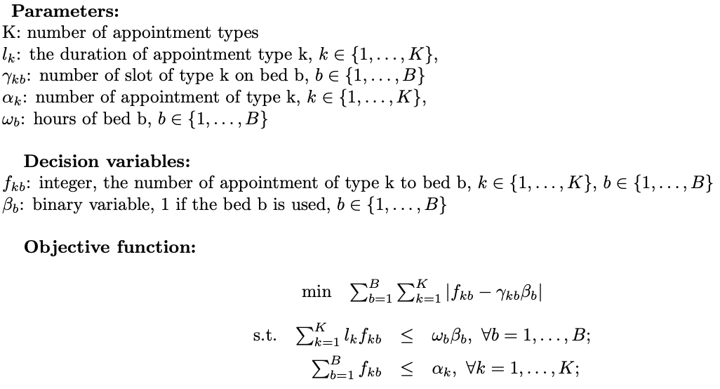
Model 3: Two step methods
The first step:

Slide 13
Models in stochastic case:
Uncertainty: the actual service time maybe more or less than the duration of the assigned appointment
Model 1’: The model in the paper (Huang et al.,2020)
Objective: minimize the number of override policy used
Decision: which policy each time slot in the template uses
Constraint on probability of having the overtime to be at most alpha
Model 3’: Two step methods
Step 1
Objective:
Minimize the difference between the number of appointment type and the type of the time slot in each bed and the bed used
Maximize the time slot assigned in each bed
Decision: the number of each type of the appointment assigned to each bed
Constraint on the probability of having overtime to be at most alpha
Step 2
Objective:
Minimize the number of override policy used
Minimize the expected idle time and wait time
Decision: the start time and the end time of an appointment assigned on each bed

Slide 14
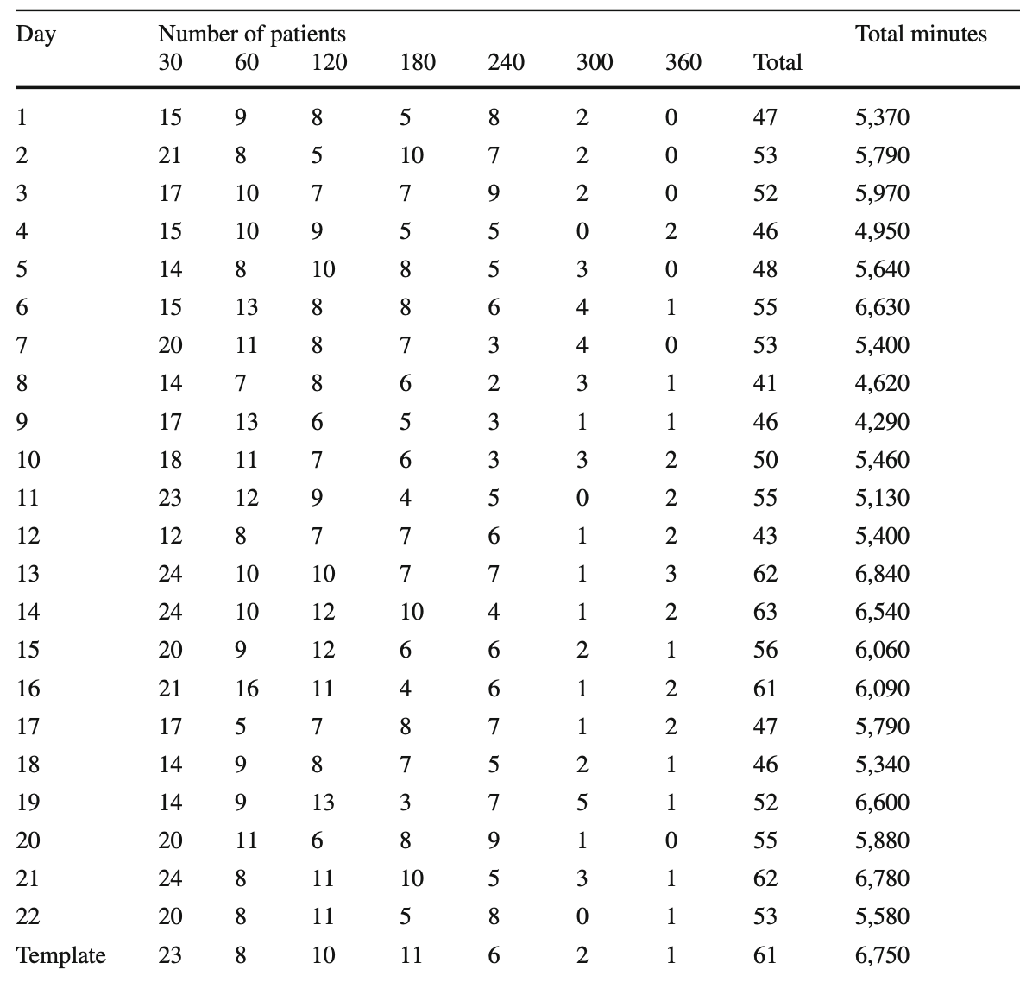
Results:
Used data from the paper: 22 days scheduling data from Andreas Cancer Centre at the Mayo Clinic

Slide 15
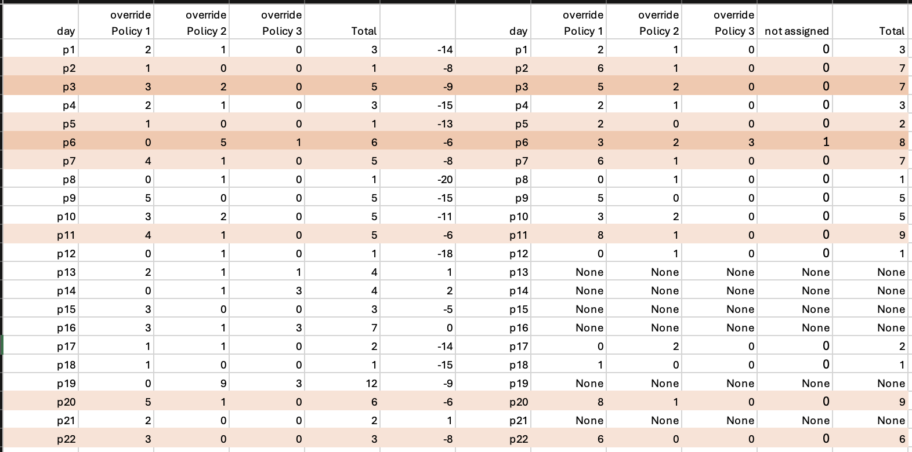
Result for stochastic case
Model 1 VS Model 1’: the model from the paper (Huang et al.,2020)
Deterministic case
Stochastic case(alpha=0.05)
*The middle column is the difference between the total number of patients and the total number of time slots
We can see that the number of the override policy in stochastic case is more than that in deterministic case when there are more appointment. When the number of appointment is close to or more than the number of time slots, it is hard for model to solve in stochastic case

Slide 16
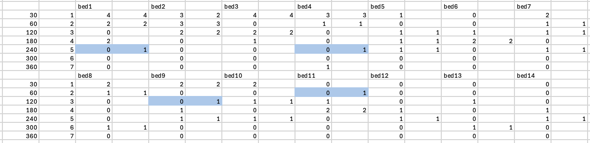
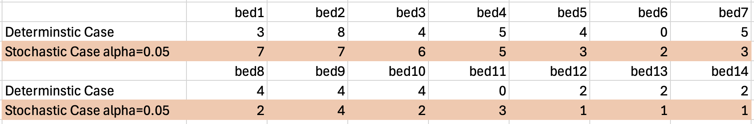
Result for stochastic case
Model 3’: two step method
It is the result of day 1, in stochastic case, more beds are used than in deterministic case. The model normally assigns an appointment to a time slot in a bed which has longer time slot available other than used time slot to accommodate the appointment which has longer actual time. So, it causes more number of override policy than in the deterministic case.

Slide 17
Result for Deterministic case
Model 1: the model from the paper (Huang et al.,2020)
day | override Policy 1 | override Policy 2 | override Policy 3 | Total | The number of assigment that need to be overriden
p1 | 2 | 1 | 0 | 3 | 3
p2 | 1 | 0 | 0 | 1 | 1
p3 | 3 | 2 | 0 | 5 | 2
p4 | 2 | 1 | 0 | 3 | 3
p5 | 1 | 0 | 0 | 1 | 1
p6 | 0 | 5 | 1 | 6 | 7
p7 | 4 | 1 | 0 | 5 | 5
p8 | 0 | 1 | 0 | 1 | 1
p9 | 5 | 0 | 0 | 5 | 5
p10 | 3 | 2 | 0 | 5 | 5
p11 | 4 | 1 | 0 | 5 | 5
p12 | 0 | 1 | 0 | 1 | 1
p13 | 2 | 1 | 1 | 4 | 6
p14 | 0 | 1 | 3 | 4 | 6
p15 | 3 | 0 | 0 | 3 | 3
p16 | 3 | 1 | 3 | 7 | 10
p17 | 1 | 1 | 0 | 2 | 2
p18 | 1 | 0 | 0 | 1 | 1
p19 | 0 | 9 | 3 | 12 | 8
p20 | 5 | 1 | 0 | 6 | 6
p21 | 2 | 0 | 0 | 2 | 3
p22 | 3 | 0 | 0 | 3 | 3
It is the result that the model generated under deterministic case

Slide 18
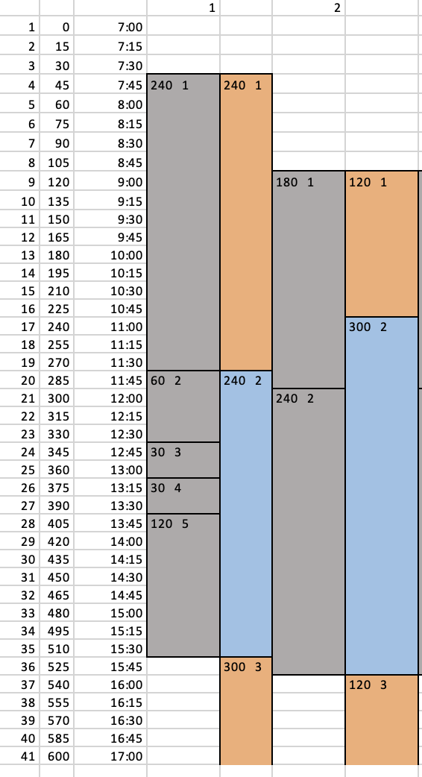
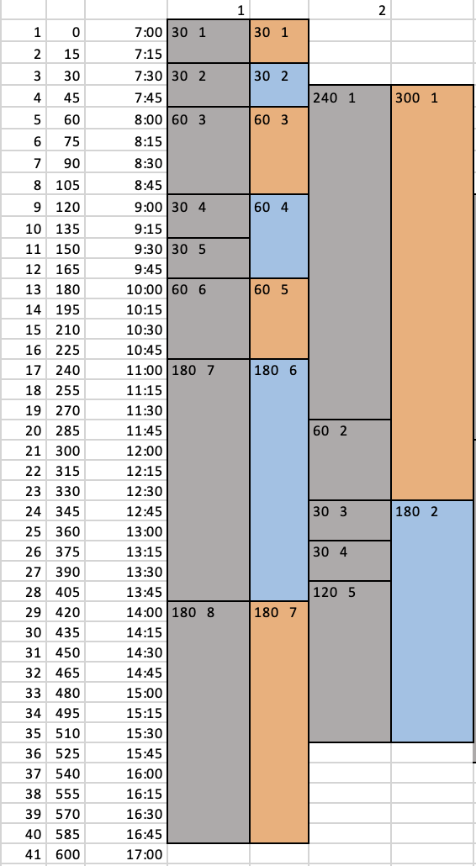
Model 2: the integrated model we purposed
They are the result of two cases by using the model 2. We can see that the start time of the appointment does not have to be the start time of the time slot. One time slot can both be split and combined with the next time slot to accommodate an appointment. And more than two time slots can be combined for an appointment.
Result of 5 appointments(120min,240min,240min,300min,300min) and 2 beds(one with 5 time slots and another with 2 time slots)
Result of 10 appointments(30min*2,60min*3,180min*3,300min*1,360min*1) and 2 beds(one with 8 time slots and another with 5 time slots)
*The appointments are randomly generated

Slide 19
Model 3: two step method
Solution structure of first step: used the example of day 1 in the paper as example
The highlight part is where need to use override policies. The result can only show which appointment should be assigned to which bed, but it’s hard to know what override policies or how many override policies would be used. Also, we can not decide the time based on it. Therefore, we will solve it in the second step.

Slide 20
Model 1 VS Model 2
Computational result
Model 1
plist | optimizer_time | elapsed time | obj_value
p1 | 0.87 | 6.8618 | 16
p2 | 1.12 | 7.4024 | 5
p3 | 0.94 | 7.2228 | 27
p4 | 0.98 | 7.1459 | 16
p5 | 1.02 | 7.0805 | 5
p6 | 1.09 | 6.9887 | 41
p7 | 0.98 | 6.64 | 26
p8 | 0.91 | 6.883 | 6
p9 | 0.89 | 6.81 | 25
p10 | 1 | 6.6406 | 27
p11 | 0.86 | 6.5357 | 26
p12 | 0.97 | 6.7411 | 6
p13 | 38.56 | 44.201 | 77
p14 | 3.11 | 8.8959 | 39
p15 | 0.89 | 6.7845 | 15
p16 | 1.69 | 7.6622 | 54
p17 | 0.94 | 6.8429 | 11
p18 | 0.87 | 6.871 | 5
p19 | 1.88 | 7.9226 | 87
p20 | 0.83 | 7.8503 | 31
p21 | 100.14 | 106.2082 | 60
p22 | 0.93 | 6.6106 | 15
Model 2
bed number | # of appointments | # of slot | elapsed time(s) | optimizer time(s) | relative gap(%)
1 | 5 | 2 | 0.79107 | 0.03 | 0
1 | 5 | 5 | 0.80692 | 0.057 | 0
1 | 10 | 5 | 1.51314 | 0.186 | 0
1 | 10 | 8 | 2.4865 | 0.55 | 0
1 | 15 | 8 | 3.62549 | 0.932 | 0
2 | 5 | 5 2 | 1.19488 | 0.168 | 0
2 | 10 | 5 2 | 3.00249 | 1.428 | 0
2 | 15 | 5 2 | 8.4 | 5.43 | 0
2 | 10 | 8 5 | 9.0882 | 6.321 | 0
2 | 15 | 8 5 | 217.75 | 213.5 | 0
2 | 20 | 8 5 | 31.21 | 25.65 | 11.5
3 | 10 | 8 5 2 | 21.68 | 18.53 | 0.000232
3 | 15 | 8 5 2 | 257.44 | 252.65 | 15
3 | 20 | 8 5 2 | 308.14 | 301.62 | 14.9
5 | 15 | 8 8 7 5 4 | 1396.9743 | 1674.575 | 19.8
10 | 10 | 8 8 7 5 4 3 5 4 4 4 | 252.81501 | 241.099 | 0.3
10 | 15 | 8 8 7 5 4 3 5 4 4 4 | 318.23 | 300.2 | 20.2
The model 1 runs much faster than model 2. The computation time for model 1 does not change a lot besides some complicated cases, while the computation time of model 2 is exponential. When the number of appointment and bed is really low, model 2 works better than model 1. But if we want to use the clinical data in the paper, model 2 does not work.

Slide 21
Model1 VS Model1’
Model 1’ when alpha=0.05
Model 1
str_p | optimizer_time | elapsed time | obj_value | relative gap
p1 | 1.81 | 10.2693 | 16 | 0
p2 | 993.13 | 1000.5099 | 35.99999998 | 0
p3 | 42.15 | 49.5648 | 37 | 0
p4 | 1.08 | 8.2572 | 16 | 0
p5 | 1.47 | 8.5395 | 10 | 0
p6 | 1201.16 | 1208.6941 | 110 | 0
p7 | 2323.93 | 2331.2045 | 36 | 0
p8 | 1.54 | 8.765 | 6 | 0
p9 | 0.95 | 7.8374 | 25 | 0
p10 | 2.39 | 9.5238 | 27 | 0
p11 | 1219.05 | 1225.9994 | 46 | 0
p12 | 1.39 | 8.5538 | 5.999999653 | 0
p13 | 2909.4 |  |  | 27.9
p14 | 20556.1 |  |  | 39.2
p15 | 26622.8 |  |  | 14.5
p16 | 2301.9 |  |  | 15.1
p17 | 1.91 | 11.11 | 12 | 0
p18 | 0.83 | 8.2656 | 5 | 0
p19 | 1295.6 |  |  | 16.1
p20 | 561.49 | 570.7452 | 46 | 0
p21 | 2326.2 |  |  | 26.8
p22 | 606.32 | 615.7286 | 30 | 0
plist | optimizer_time | elapsed time | obj_value
p1 | 0.87 | 6.8618 | 16
p2 | 1.12 | 7.4024 | 5
p3 | 0.94 | 7.2228 | 27
p4 | 0.98 | 7.1459 | 16
p5 | 1.02 | 7.0805 | 5
p6 | 1.09 | 6.9887 | 41
p7 | 0.98 | 6.64 | 26
p8 | 0.91 | 6.883 | 6
p9 | 0.89 | 6.81 | 25
p10 | 1 | 6.6406 | 27
p11 | 0.86 | 6.5357 | 26
p12 | 0.97 | 6.7411 | 6
p13 | 38.56 | 44.201 | 77
p14 | 3.11 | 8.8959 | 39
p15 | 0.89 | 6.7845 | 15
p16 | 1.69 | 7.6622 | 54
p17 | 0.94 | 6.8429 | 11
p18 | 0.87 | 6.871 | 5
p19 | 1.88 | 7.9226 | 87
p20 | 0.83 | 7.8503 | 31
p21 | 100.14 | 106.2082 | 60
p22 | 0.93 | 6.6106 | 15
Model 1’ runs much slower because stochastic case is involved

Slide 22
First step in Model3 VS Model 3’: Comparison between deterministic case and alpha=0.05
Model 3
Model 3’ when alpha=0.05
str_p | optimizer time | elapsed time | obj value | relative gap(%)
p1 | 0.04 | 0.8195 | -4677.6898 | 0
p2 | 0.08 | 0.5506 | -5303.8949 | 0.00943
p3 | 0.05 | 0.505 | -5151.4847 | 0.00867
p4 | 0.05 | 0.6066 | -4576.312829 | 0.0078
p5 | 0.04 | 0.5228 | -4802.28439 | 0.00694
p6 | 0.06 | 0.5144 | -5430.06878 | 0.00767
p7 | 0.08 | 0.5119 | -5251.26878 | 0.00555
p8 | 0.11 | 0.5381 | -4098.28439 | 0
p9 | 0.19 | 0.6158 | -4559.5 | 0.00792
p10 | 0.26 | 0.7171 | -4948.497219 | 0.00989
p11 | 0.06 | 0.5078 | -5455.112829 | 0.00917
p12 | 0.06 | 0.4895 | -4299.512829 | 0.00896
p13 | 2.46 | 2.8985 | -6056.207729 | 0
p14 | 0.07 | 0.4958 | -6245.692829 | 0.00801
p15 | 0.02 | 0.4452 | -5585.28 | 0.00746
p16 | 0.07 | 0.4938 | -5996.402829 | 0
p17 | 0.15 | 0.6326 | -4684.407729 | 0.00712
p18 | 0.07 | 0.4925 | -4607.9 | 0.0085
p19 | 0.09 | 0.5196 | -5102.71807 | 0.0098
p20 | 0.09 | 0.5856 | -5439.3847 | 0.0097
p21 | 15.04 | 15.4649 | -6100.69 | 0
p22 | 0.03 | 0.4581 | -5276.4798 | 0.00474
str_p | optimizer time | elapsed time | obj-value | relative gap（%）
p1 | 20.6 | 23.7563 | -4647.379812 | 0
p2 | 1005.13 | 1006.3112 | -5197.7439 | 0.49
p3 | 1006.36 | 878.4827 | -5065.6647 | 0.82
p4 | 200.87 | 201.6831 | -4545.902829 | 0.00939
p5 | 58.57 | 59.5282 | -4737.35439 | 0
p6 | 965.06 | 322.9638 | -5179.80778 | 3.34
p7 | 1002.74 | 868.1317 | -5202.06878 | 0.25
p8 | 5.15 | 5.9532 | -4094.284394 | 0
p9 | 4.22 | 5.043 | -4555.500018 | 0.00611
p10 | 1126.17 | 868.5074 | -4910.397219 | 0.17
p11 | 2005.89 | 982.8523 | -5380.292829 | 0.23
p12 | 24.68 | 25.5071 | -4270.412829 | 0
p13 | 1011.86 | 878.6339 | -5797.669831 | 2.78
p14 | 1013.94 | 979.6179 | -6001.719 | 2.33
p15 | 1826.44 | 849.6368 | -5462.05 | 0.84
p16 | 1073.78 | 690.1917 | -5878.582829 | 0.76
p17 | 218.55 | 219.3763 | -4634.097729 | 0.00686
p18 | 80.64 | 81.3918 | -4566.490012 | 0
p19 | 1012.13 | 1012.9541 | -4899.00246 | 2.41
p20 | 1153.37 | 584.1219 | -5363.233726 | 0.54
p21 | 700.85 | 91.8904 | -5811.56 | 3.58
p22 | 629.05 | 629.9385 | -5201.6598 | 0
Model 3’ runs much slower. And in some cases, the computation time of model3’ depends on different cases.

Slide 23
Model 3’: alpha=0.05 VS alpha=0.02
alpha=0.05
alpha=0.02
str_p | optimizer time | elapsed time | obj-value | relative gap（%）
p1 | 20.6 | 23.7563 | -4647.379812 | 0
p2 | 1005.13 | 1006.3112 | -5197.7439 | 0.49
p3 | 1006.36 | 878.4827 | -5065.6647 | 0.82
p4 | 200.87 | 201.6831 | -4545.902829 | 0.00939
p5 | 58.57 | 59.5282 | -4737.35439 | 0
p6 | 965.06 | 322.9638 | -5179.80778 | 3.34
p7 | 1002.74 | 868.1317 | -5202.06878 | 0.25
p8 | 5.15 | 5.9532 | -4094.284394 | 0
p9 | 4.22 | 5.043 | -4555.500018 | 0.00611
p10 | 1126.17 | 868.5074 | -4910.397219 | 0.17
p11 | 2005.89 | 982.8523 | -5380.292829 | 0.23
p12 | 24.68 | 25.5071 | -4270.412829 | 0
p13 | 1011.86 | 878.6339 | -5797.669831 | 2.78
p14 | 1013.94 | 979.6179 | -6001.719 | 2.33
p15 | 1826.44 | 849.6368 | -5462.05 | 0.84
p16 | 1073.78 | 690.1917 | -5878.582829 | 0.76
p17 | 218.55 | 219.3763 | -4634.097729 | 0.00686
p18 | 80.64 | 81.3918 | -4566.490012 | 0
p19 | 1012.13 | 1012.9541 | -4899.00246 | 2.41
p20 | 1153.37 | 584.1219 | -5363.233726 | 0.54
p21 | 700.85 | 91.8904 | -5811.56 | 3.58
p22 | 629.05 | 629.9385 | -5201.6598 | 0
str_p | optimizer time | elapsed time | obj value | relative gap(%)
p1 | 14.64 | 20.317 | -4647.3798 | 0
p2 | 1065.67 | 942.8473 | -5198.4829 | 0.39
p3 | 1005.74 | 1006.798 | -5065.664738 | 0.61
p4 | 55.07 | 55.9599 | -4545.902829 | 0.00781
p5 | 36.73 | 37.7226 | -4737.35439 | 0
p6 | 1009.79 | 889.7986 | -5177.322682 | 2.79
p7 | 691.36 | 692.2525 | -5202.06878 | 0.00298
p8 | 2.54 | 3.3249 | -4094.284391 | 0
p9 | 2.44 | 3.2778 | -4555.5 | 0
p10 | 641.84 | 642.9106 | -4910.397219 | 0
p11 | 981.6 | 15.9158 | -5377.497729 | 0.85
p12 | 15.85 | 16.6506 | -4270.412829 | 0
p13 | 951.6 | 45.5595 | -5754.641629 | 3.76
p14 | 1061 | 127.4217 | -5987.078073 | 2.46
p15 | 1060.12 | 138.7301 | -5447.6139 | 1.3
p16 | 1096.26 | 126.1211 | -5877.582914 | 0.95
p17 | 1121.09 | 138.1156 | -4634.097729 | 0.29
p18 | 47.56 | 48.3147 | -4566.49 | 0
p19 | 611.11 | 82.268 | -4884.71807 | 2.86
p20 | 1093.34 | 137.871 | -5363.2337 | 0.59
p21 | 1180.12 | 264.6544 | -5792.919 | 3.18
p22 | 1063.76 | 144.8889 | -5201.659811 | 0.25
In most cases, alpha=0.02 runs faster than alpha=0.05. I highlighted the cases that alpha=0.02 runs slower than alpha=0.05 because it is not expected. We will do more analysis on it.

Slide 24
Model 1’ VS Model3’: Comparison of the stochastic case between the model in original paper and the first step alpha=0.05
Model 1’
Model3’
str_p | optimizer_time | elapsed time | obj_value | relative gap
p1 | 1.81 | 10.2693 | 16 | 0
p2 | 993.13 | 1000.5099 | 35.99999998 | 0
p3 | 42.15 | 49.5648 | 37 | 0
p4 | 1.08 | 8.2572 | 16 | 0
p5 | 1.47 | 8.5395 | 10 | 0
p6 | 1201.16 | 1208.6941 | 110 | 0
p7 | 2323.93 | 2331.2045 | 36 | 0
p8 | 1.54 | 8.765 | 6 | 0
p9 | 0.95 | 7.8374 | 25 | 0
p10 | 2.39 | 9.5238 | 27 | 0
p11 | 1219.05 | 1225.9994 | 46 | 0
p12 | 1.39 | 8.5538 | 5.999999653 | 0
p13 | 2909.4 |  |  | 27.9
p14 | 20556.1 |  |  | 39.2
p15 | 26622.8 |  |  | 14.5
p16 | 2301.9 |  |  | 15.1
p17 | 1.91 | 11.11 | 12 | 0
p18 | 0.83 | 8.2656 | 5 | 0
p19 | 1295.6 |  |  | 16.1
p20 | 561.49 | 570.7452 | 46 | 0
p21 | 2326.2 |  |  | 26.8
p22 | 606.32 | 615.7286 | 30 | 0
str_p | optimizer time | elapsed time | obj-value | relative gap（%）
p1 | 20.6 | 23.7563 | -4647.379812 | 0
p2 | 1005.13 | 1006.3112 | -5197.7439 | 0.49
p3 | 1006.36 | 878.4827 | -5065.6647 | 0.82
p4 | 200.87 | 201.6831 | -4545.902829 | 0.00939
p5 | 58.57 | 59.5282 | -4737.35439 | 0
p6 | 965.06 | 322.9638 | -5179.80778 | 3.34
p7 | 1002.74 | 868.1317 | -5202.06878 | 0.25
p8 | 5.15 | 5.9532 | -4094.284394 | 0
p9 | 4.22 | 5.043 | -4555.500018 | 0.00611
p10 | 1126.17 | 868.5074 | -4910.397219 | 0.17
p11 | 2005.89 | 982.8523 | -5380.292829 | 0.23
p12 | 24.68 | 25.5071 | -4270.412829 | 0
p13 | 1011.86 | 878.6339 | -5797.669831 | 2.78
p14 | 1013.94 | 979.6179 | -6001.719 | 2.33
p15 | 1826.44 | 849.6368 | -5462.05 | 0.84
p16 | 1073.78 | 690.1917 | -5878.582829 | 0.76
p17 | 218.55 | 219.3763 | -4634.097729 | 0.00686
p18 | 80.64 | 81.3918 | -4566.490012 | 0
p19 | 1012.13 | 1012.9541 | -4899.00246 | 2.41
p20 | 1153.37 | 584.1219 | -5363.233726 | 0.54
p21 | 700.85 | 91.8904 | -5811.56 | 3.58
p22 | 629.05 | 629.9385 | -5201.6598 | 0
Model 1’ can solve more cases than model 3’ and runs faster than model 3’.

Slide 25
Summary
Model 1
Faster to solve
Is not flexible to accommodate the appointments
Model 2
Can decide the start time and end time for the appointment which does not have to be the start time or end time of the time slot
Slower to solve, does not work well in the clinical data
Model 3
Is faster than model 2 to solve the problem in two steps
But still slower than model 1
The result may be local optimum
Model 1’
Can deal with stochastic case based on model 1
Faster to solve than model 3’
Not all cases can be solved
Can only consider the case when there’s wait time
Model 3’
Can consider both idle time and wait time
Run slower than model 1’
The result may be local optimum

